Slide 1
Plan for reproducing PFC deadlock case
Step 1: manually configure a routing loop and observe the behavior of PFC deadlock.
How long will it take to form a PFC deadlock after a loop occurs?

Slide 2
Plan for reproducing PFC deadlock case
Step 1: manually configure a routing loop and observe the behavior of PFC deadlock.
How long will it take to form a PFC deadlock after a loop occurs?
How long will it take for BGP to eliminate the routing loop?

Slide 3
Plan for reproducing PFC deadlock case
Step 1: manually configure a routing loop and observe the behavior of PFC deadlock.
How long will it take to form a PFC deadlock after a loop occurs?
How long will it take for BGP to eliminate the routing loop?
How long at least will it take to break the PFC deadlock by changing the related switch queues into lossy? How many packets will be lost during the recovery?

Slide 4
Plan for reproducing PFC deadlock case
Step 1: manually configure a routing loop and observe the behavior of PFC deadlock.
How long will it take to form a PFC deadlock after a loop occurs?
How long will it take for BGP to eliminate the routing loop?
How long at least will it take to break the PFC deadlock by changing the related switch queues into lossy? How many packets will be lost during the recovery?
How long will it take an RDMA connection to recover after a lot of packets being dropped in the network?

Slide 5
Plan for reproducing PFC deadlock case
Step 2: reproduce the multi-hop PFC deadlock case caused by switch failure.
How long will it take for a switch to detect the failure of its neighbor switch? Maybe we need to consider different failure detection mechanisms.

Slide 6
Plan for reproducing PFC deadlock case
Step 2: reproduce the multi-hop PFC deadlock case caused by switch failure.
How long will it take for a switch to detect the failure of its neighbor switch? Maybe we need to consider different failure detection mechanisms.
How long will it take for a switch to detect the recovery of its neighbor switch?

Slide 7
Plan for reproducing PFC deadlock case
Step 2: reproduce the multi-hop PFC deadlock case caused by switch failure.
How long will it take for a switch to detect the failure of its neighbor switch? Maybe we need to consider different failure detection mechanisms.
How long will it take for a switch to detect the recovery of its neighbor switch?
How long will it take for BGP to converge after we repair the failed switch?

Slide 8
Plan for reproducing PFC deadlock case
Step 2: reproduce the multi-hop PFC deadlock case caused by switch failure.
How long will it take for a switch to detect the failure of its neighbor switch? Maybe we need to consider different failure detection mechanisms.
How long will it take for a switch to detect the recovery of its neighbor switch?
How long will it take for BGP to converge after we repair the failed switch?
Will it help to simply change the network into lossy before the routing loop converges?

Slide 9
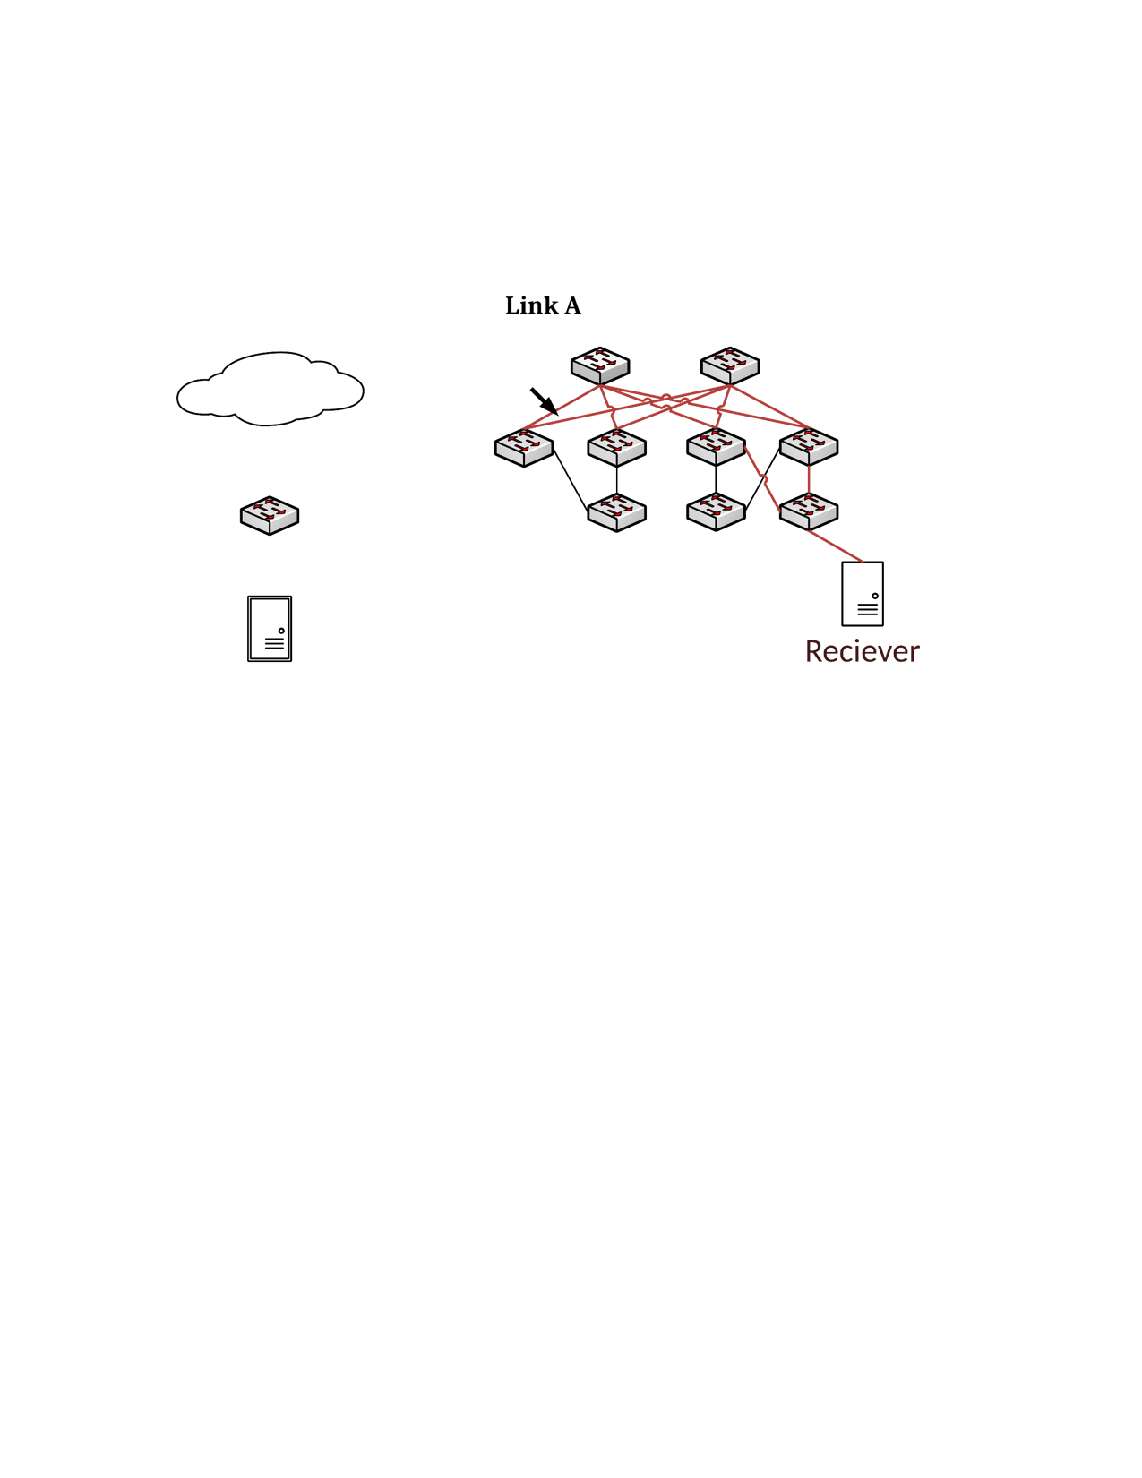

PFC deadlock case 1
Core 1
Core 2
10.0.0.0/16 -> Aggr 1,2
10.1.0.0/16 -> Aggr 3,4
10.1.0.0/24 -> ToR 3
10.1.1.0/24 -> ToR 4
Default -> Core 1,2
Aggr 1
Aggr 2
Aggr 3
Aggr 4
ToR 1
ToR 2
ToR 3
ToR 4
H1: 10.0.0.1
H2: 10.1.1.1

